Slide 1
Data Project
By: Kasiab Lor

Slide 2
What is my project?
Read for fun
Back in middle school & high school, slow reader
Recommended minutes: 15-30 minutes
Recommended pages: 20 pages
Is my average reading pages greater than the recommended 20 pages of 30 mins per day?
Problem: number of words on a page

Slide 3
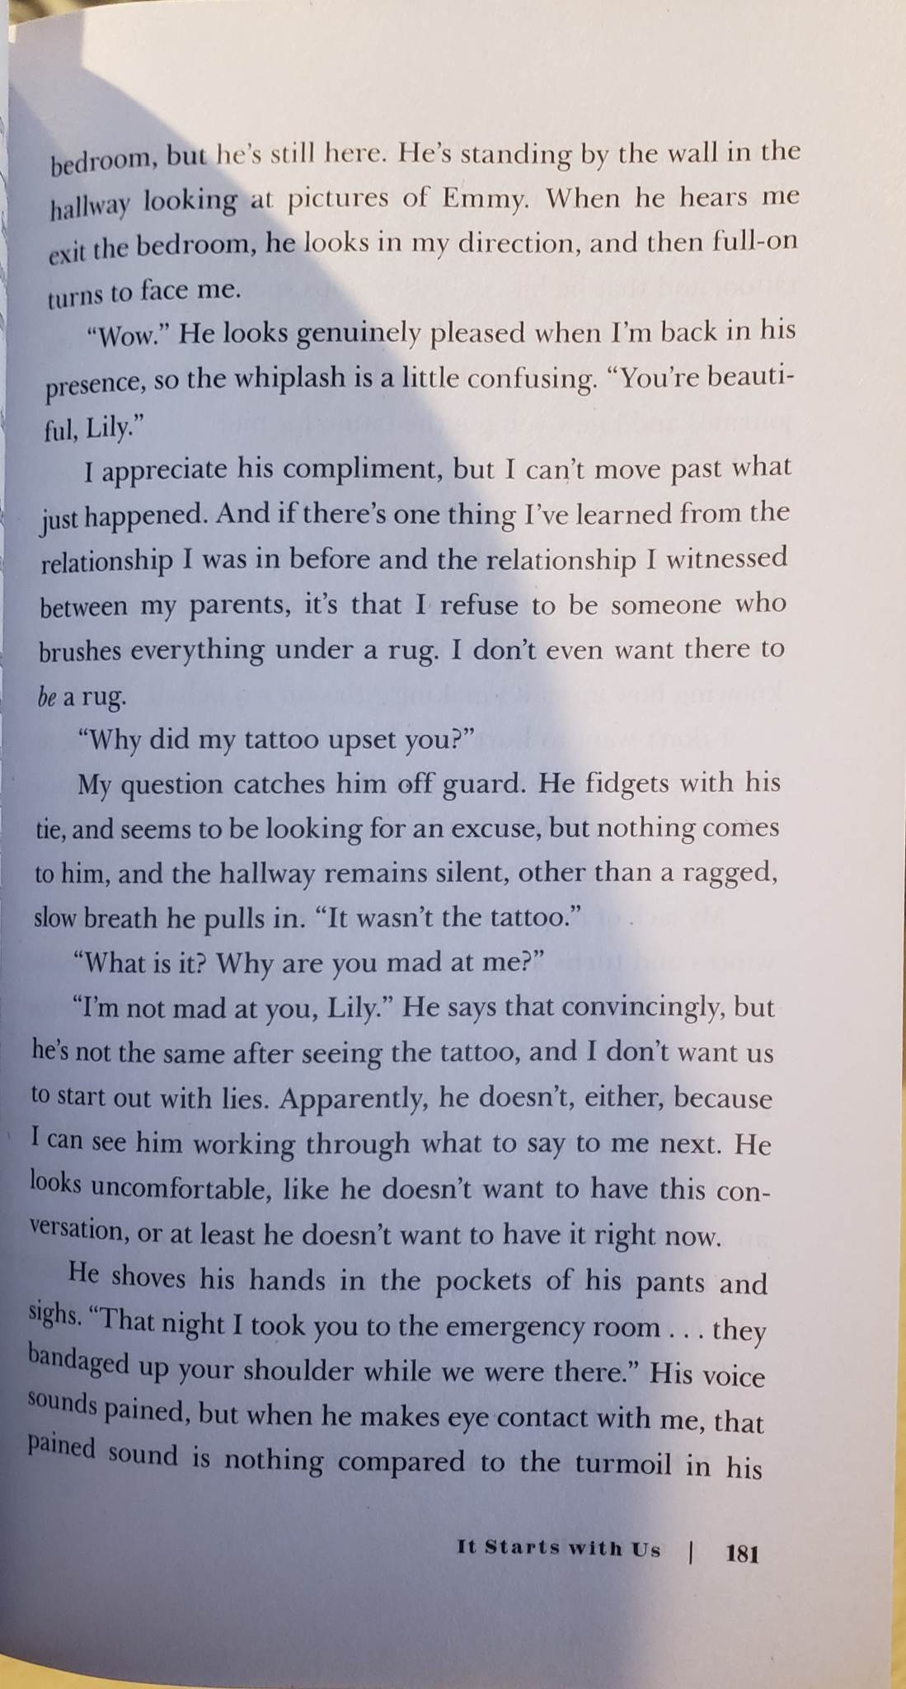


Books Read
Example of written text in book
Initially read, but finished it in 13 days
Read for my last 2 days of collecting data

Slide 4
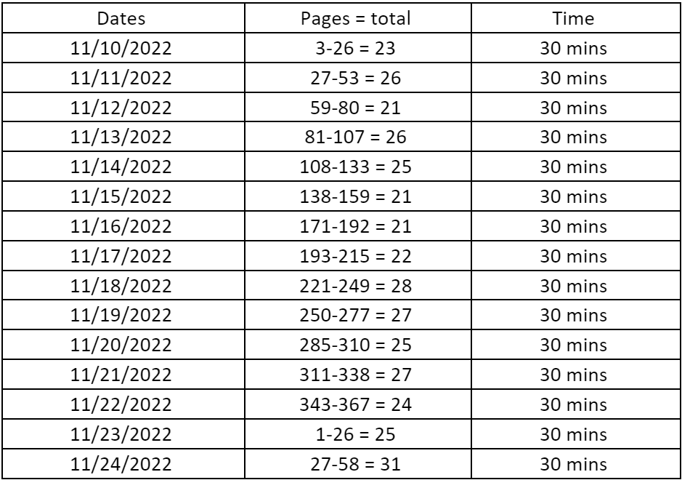
Is my average reading pages greater than the recommended 20 pages in 30 mins per day?
Data
15 days of data collecting
Hypothesis:
Ho: mu = 20, Ha: mu > 20
Variables
x=Dates, y=Pages
Depending on my day it will affect the number of pages read

Slide 5
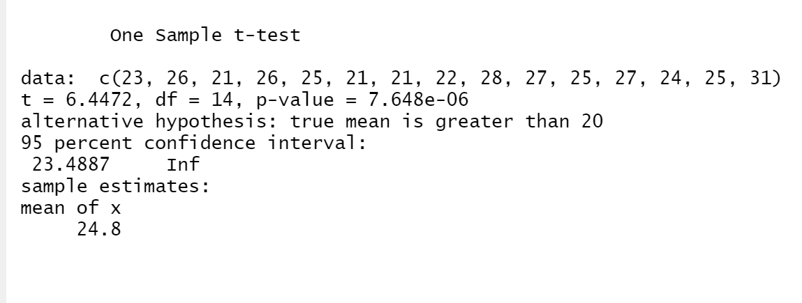
One-Sample T-Test
t.test(x=c(23,26,21,26,25,21,21,22,28,27,25,27,24,25,31), mu = 20, alternative="greater")
Reject Ho. There is enough evidence to support the claim that the mean pages read in 30 minutes are greater than the recommended 20 pages in 30 minutes per day.

Slide 6
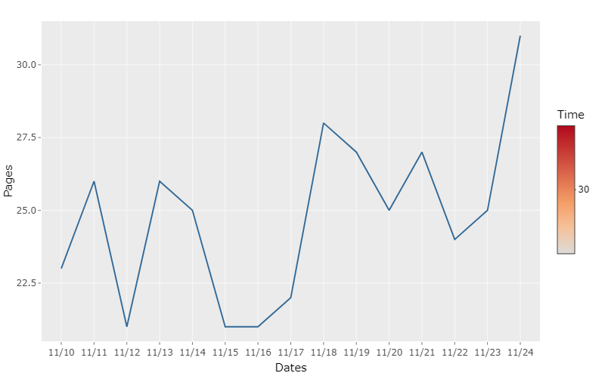
Graphs
line<-ggplot(data=mydf, aes(x=Dates,y=Pages))+geom_line(aes(group=Time,color=Time))
ggplotly(line)
Shows the pages read over 2 weeks time

Slide 7
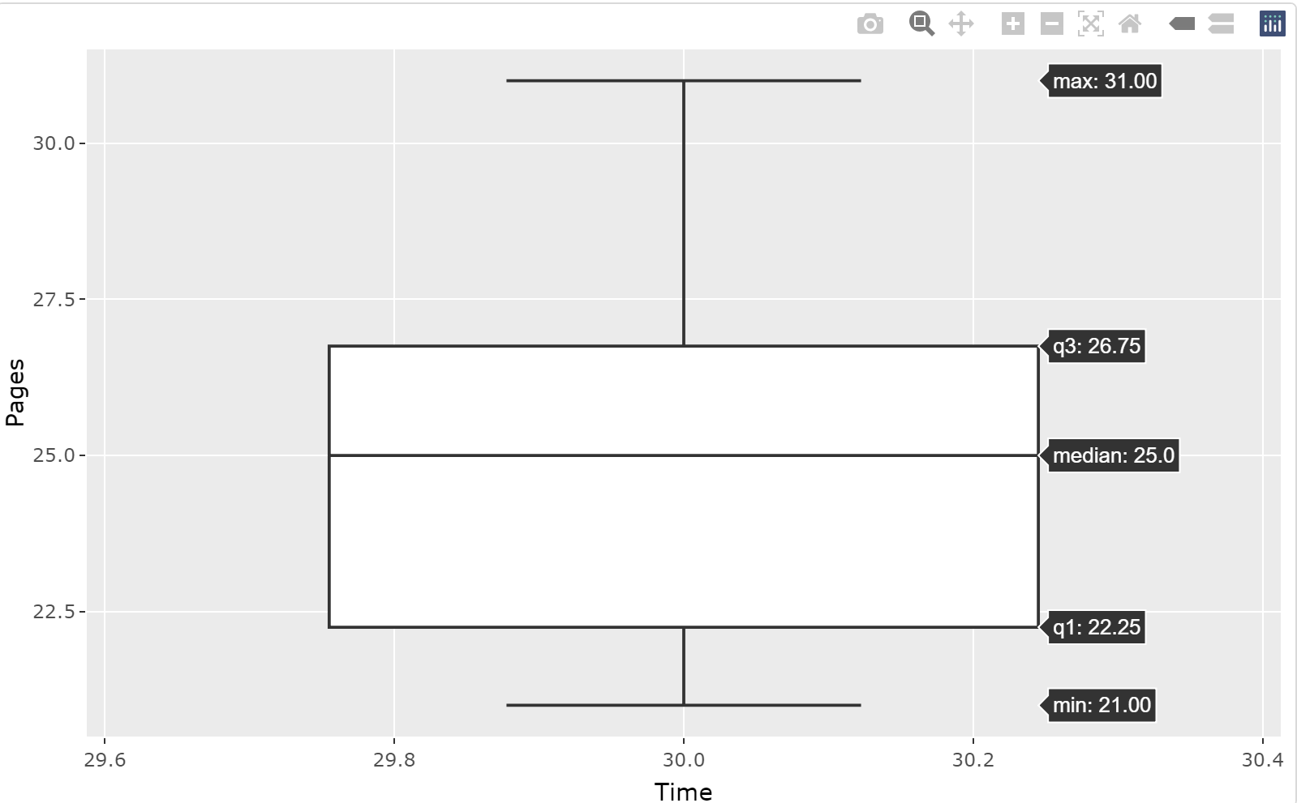
Graphs(cont.)
graph<-ggplot(data=mydf, aes(x=Time,y=Pages))+geom_boxplot()
ggplotly(graph) – interactive graph
Able to see the max, min, and medium
No outliers

Slide 8
Conclusion
Average: 24.8/25 pages read in 30 mins in a day
Least productive day(s): 3 days with 21 pages
Most productive day(s): 1 day with 31 pages
Can read more than 20 pages in 30 minutes in a day

Slide 9
References
Lastiri, Lorea. “How Many Books Can You Read If You Read 30 Minutes a Day?” Iris Reading, 23 Mar. 2022, https://irisreading.com/how-many-books-can-you-read-if-you-read-30-minutes-a-day/#:~:text=How%20many%20pages%20can%20you,you%20are%20a%20slow%20reader.

